Slide 1

FPGA Design for Embedded Systems
[Video Title]
[Instructor Name(s)]
[Department Name]
Hardware Description Languages for Logic Design
Copyright © 2019 University of Colorado

Slide 2
VHDL Simulation Example : 4-bit Adder
-- Entity
entity Add4 is port (
Data1,Data2 : in std_logic_vector(3 downto 0);
Cin : in std_logic;
Cout : out std_logic;
Sum : out std_logic_vector(3 downto 0) );
end entity Add4;
-- Architecture
architecture RTL of Add4 is
signal Out5bit : std_logic_vector(4 downto 0);
begin
Out5bit <= (‘0’ & Data1) + (‘0’ & Data2) + Cin;
Sum <= Out5bit(3 downto 0); -- 4 bits
Cout <= Out5bit(4); -- 5th bit
end architecture RTL;
Copyright © 2019 University of Colorado

Slide 3
Downloading ModelSim : Go to Link :
https://www.mentor.com/company/higher_ed/modelsim-student-edition
Copyright © 2019 University of Colorado

Slide 4
Downloading ModelSim Alternative
If you took the Introduction to FPGA Design Course, Course 1 of this video series, you may already have : ModelSim-Altera version of ModelSim installed.
If you did not take Course 1 the Altera FPGA version is still a good alternative.
Follow the directions in ALTERA QUARTUS DOWNLOAD AND INSTALLATION.docx to install the Altera version of ModelSim.
Copyright © 2019 University of Colorado

Slide 5
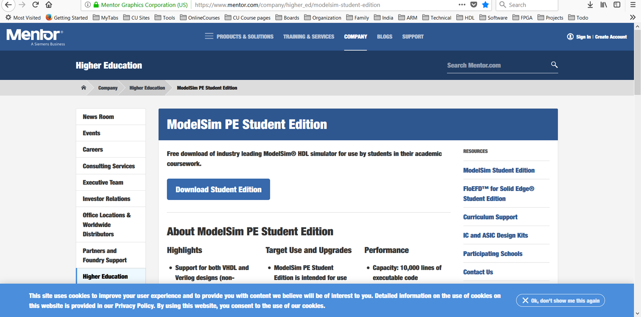

Downloading Modelsim
Copyright © 2019 University of Colorado

Slide 6
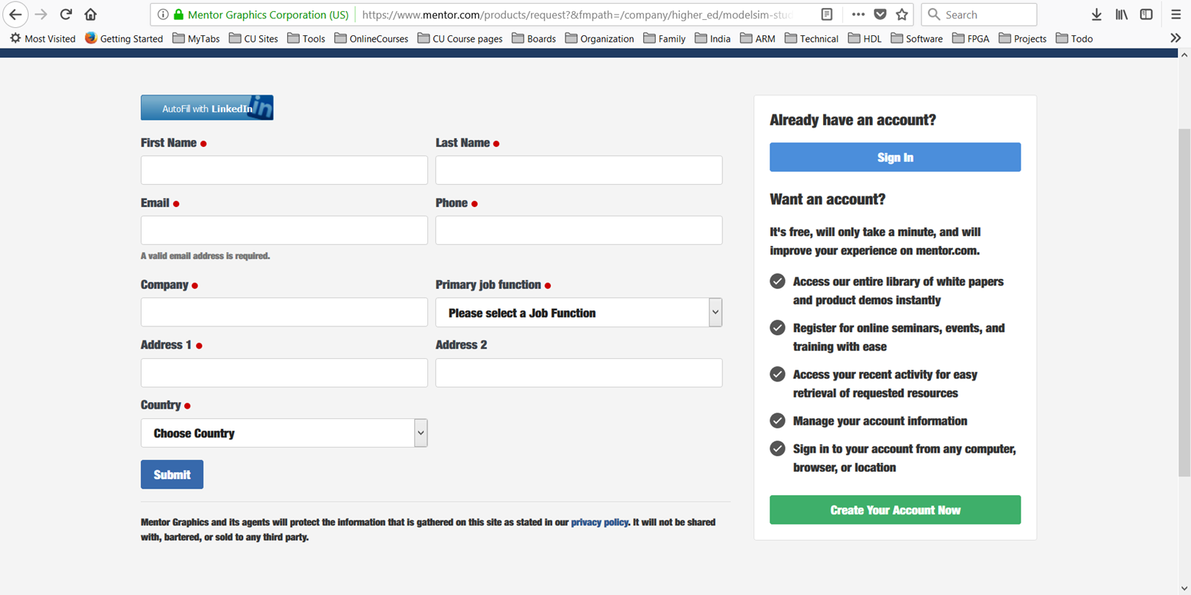
Downloading Modelsim
Copyright © 2019 University of Colorado

Slide 7
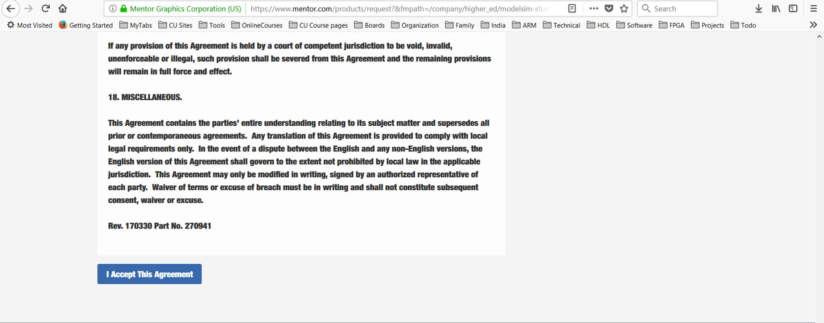
Downloading Modelsim
Copyright © 2019 University of Colorado

Slide 8
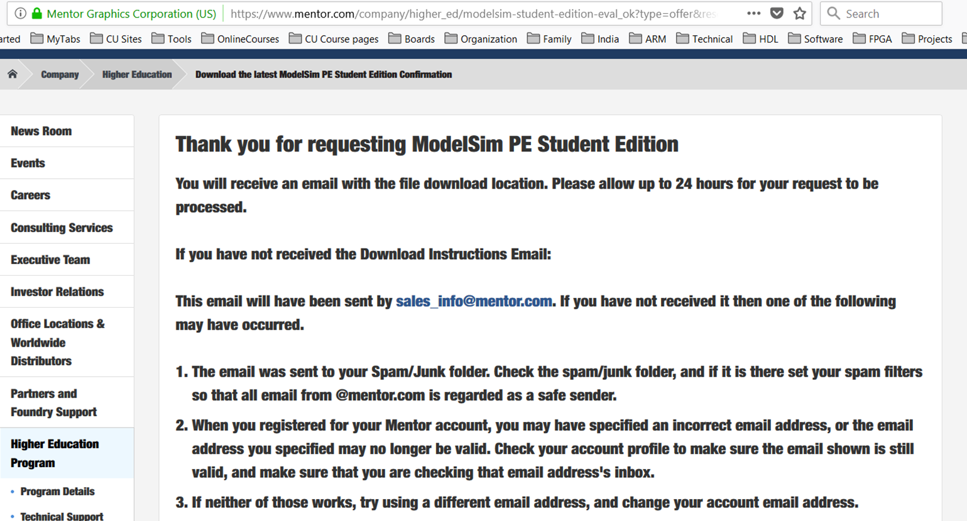
Downloading Modelsim
Copyright © 2019 University of Colorado

Slide 9
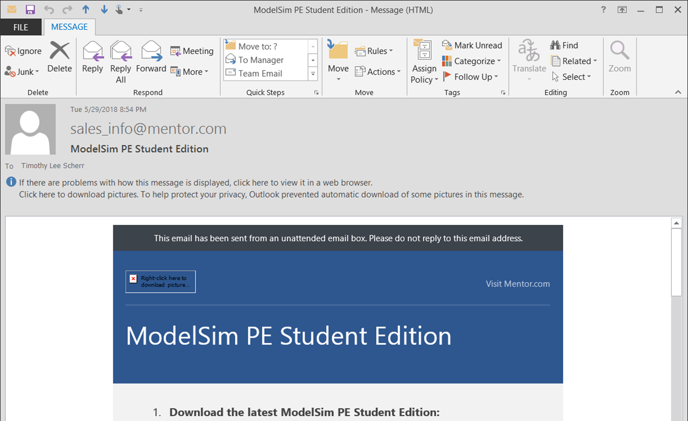
Downloading Modelsim
Copyright © 2019 University of Colorado

Slide 10
Installing ModelSim
After the file downloads completely, double-click on the .exe file to begin the installation process.
You must agree to the Mentor Graphics End-User License agreement during installation to continue.
Copyright © 2019 University of Colorado

Slide 11
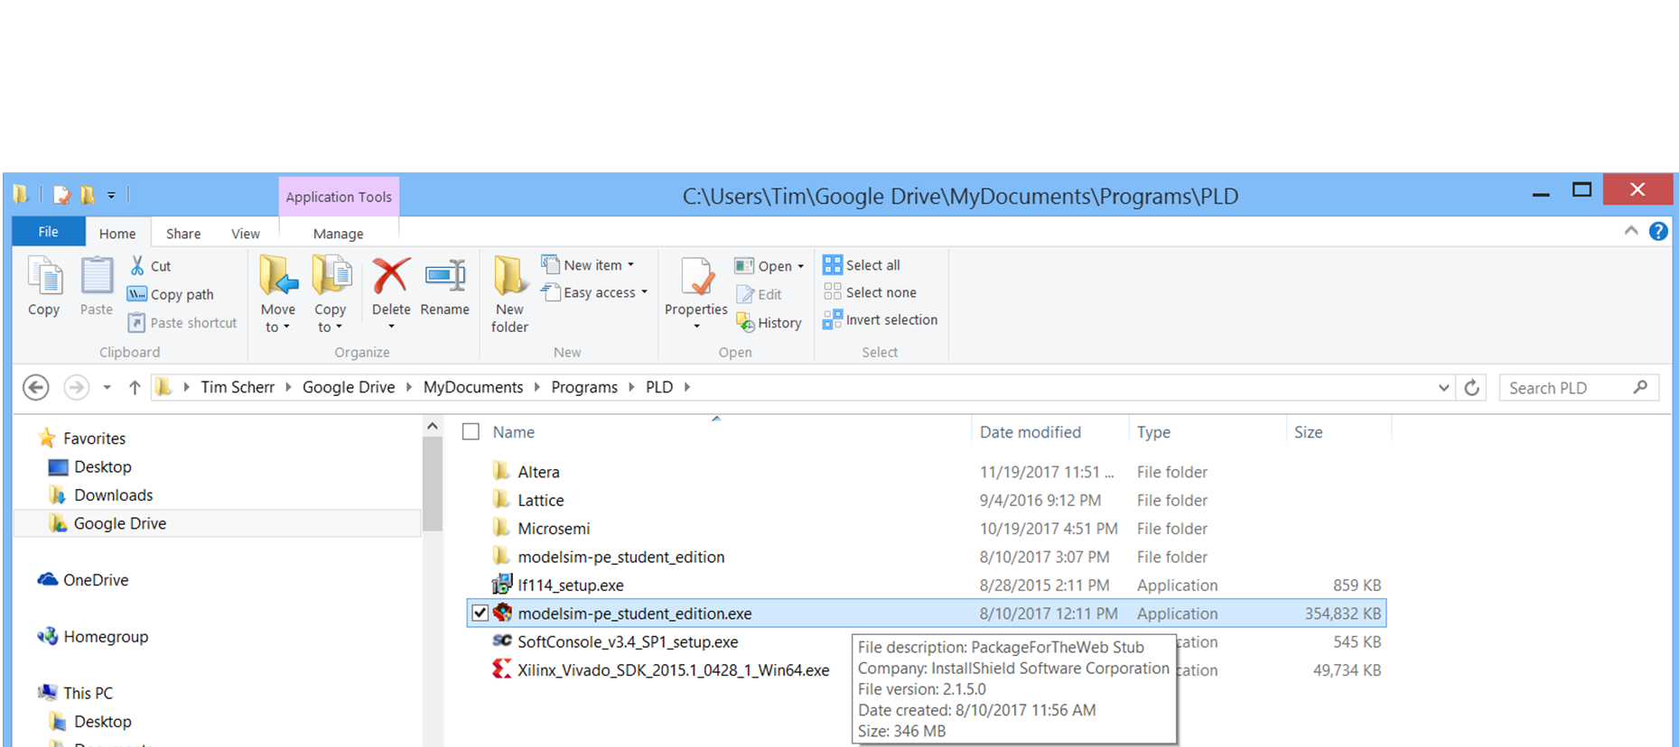
Installing ModelSim
Double-click on the .exe file to begin the installation process.
Copyright © 2019 University of Colorado

Slide 12
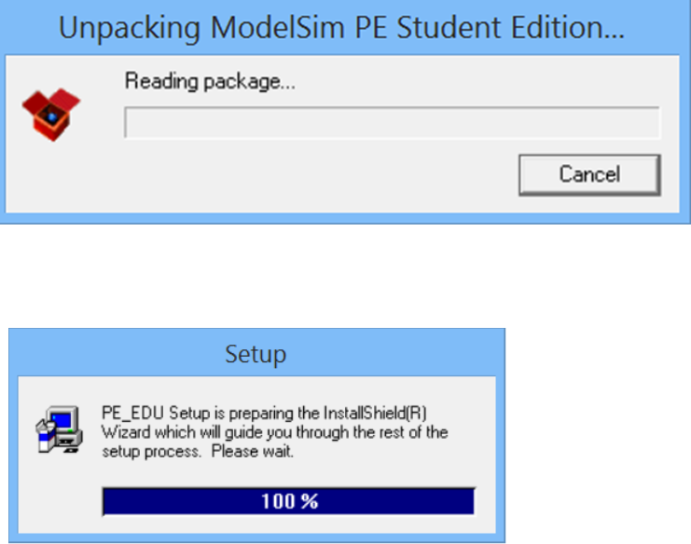
Installing ModelSim
Copyright © 2019 University of Colorado

Slide 13
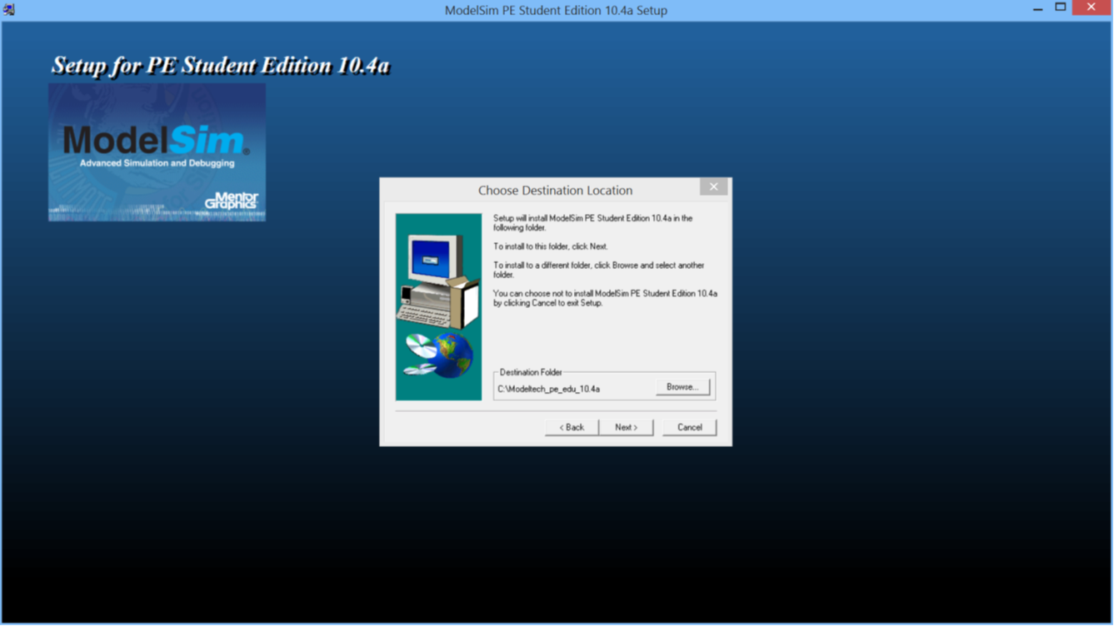
Installing ModelSim
Copyright © 2019 University of Colorado

Slide 14
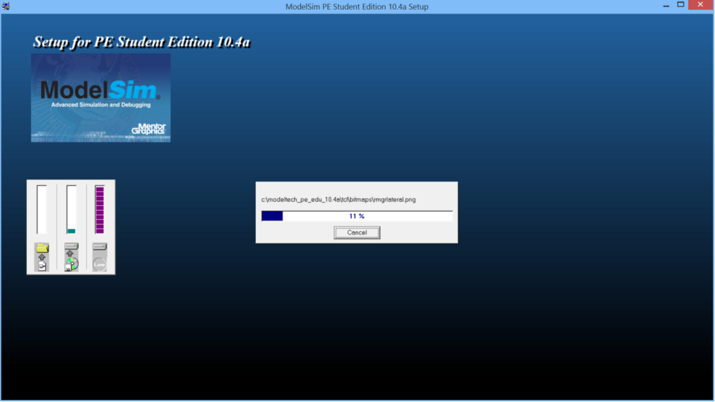
Installing ModelSim
Copyright © 2019 University of Colorado

Slide 15
Summary –
In this video, you have learned:
How to download an HDL Simulator, ModelSim from Mentor Graphics
How to install ModelSim on your PC
Copyright © 2019 University of Colorado

